Slide 1
Topological Sort

Slide 2
Introduction:
➢ Topological Sorting or Kahn's algorithm is an algorithm that orders a directed acyclic graph in a way such that each node appears before all the nodes it points to in the returned order,
i.e. if we have a --> b, a must appear before b in the topological order.
➢ Its main usage is to detect cycles in directed graphs, since no topological order is possible for a graph that contains a cycle.
Some of its uses are: deadlock detection in OS, Course schedule problem etc.

Slide 3
➢ The topological sort algorithm takes a directed graph and returns an array of the nodes where each node appears before all the nodes it points to.
➢ The ordering of the nodes in the array is called a topological ordering.

Slide 4
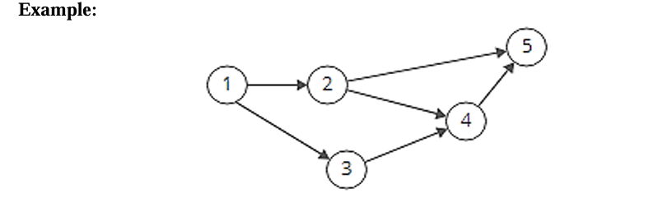

Slide 5
Since node 1 points to nodes 2 and 3, node 1 appears before them in the ordering. And, since nodes 2 and 3 both point to node 4, they appear before it in the ordering.

Slide 6
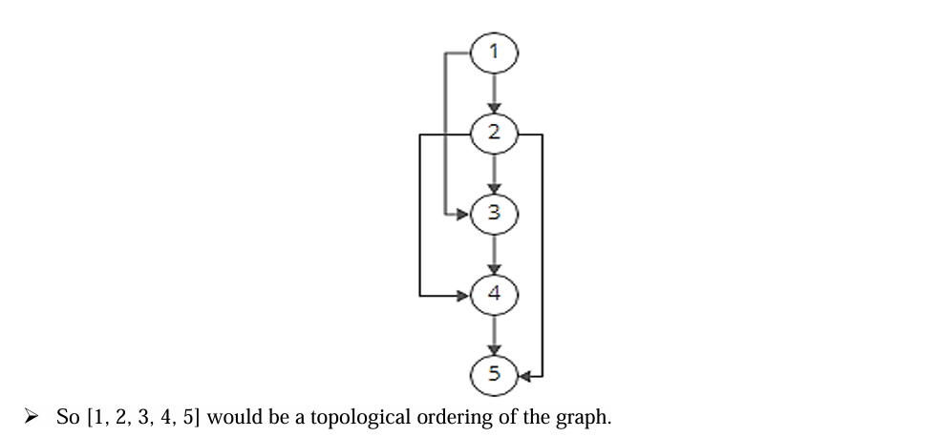

Slide 7
Can a graph have more than one valid topological ordering?
Yep! In the example above, [1, 3, 2, 4, 5] works too.

Slide 8
Why Topological Sort is not possible for graphs with undirected edges?
This is due to the fact that undirected edge between two vertices u and v means, there is an edge from u to v as well as from v to u.
Because of this both the nodes u and v depend upon each other and none of them can appear before the other in the topological ordering without creating a contradiction.

Slide 9
Why Topological Sort is not possible for graphs having cycles?
Imagine a graph with 3 vertices and edges = {1 to 2 , 2 to 3, 3 to 1} forming a cycle.
Now if we try to topologically sort this graph starting from any vertex, it will always create a contradiction to our definition.
All the vertices in a cycle are indirectly dependent on each other hence topological sorting fails.

Slide 10
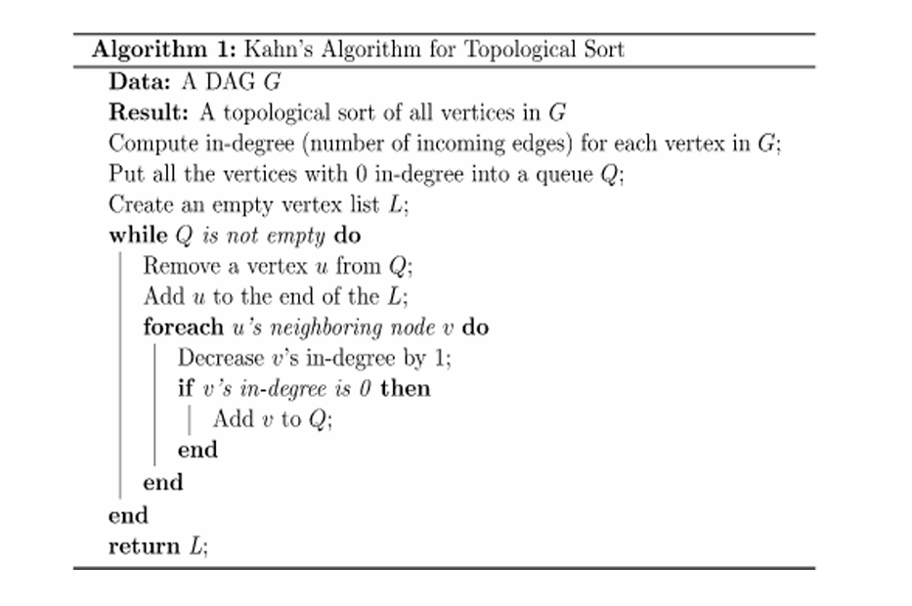

Slide 11
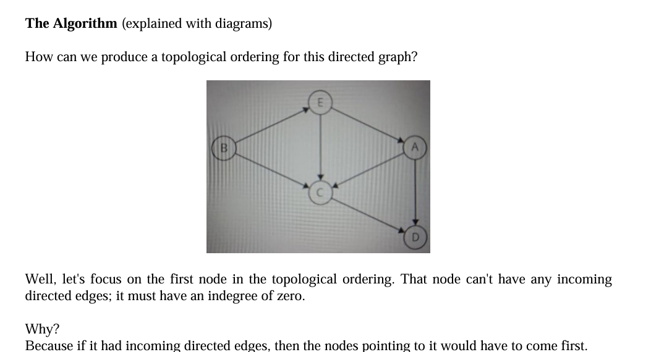

Slide 12
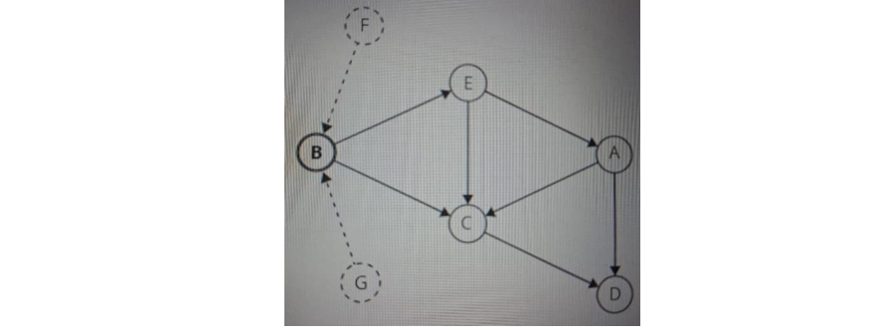

Slide 13
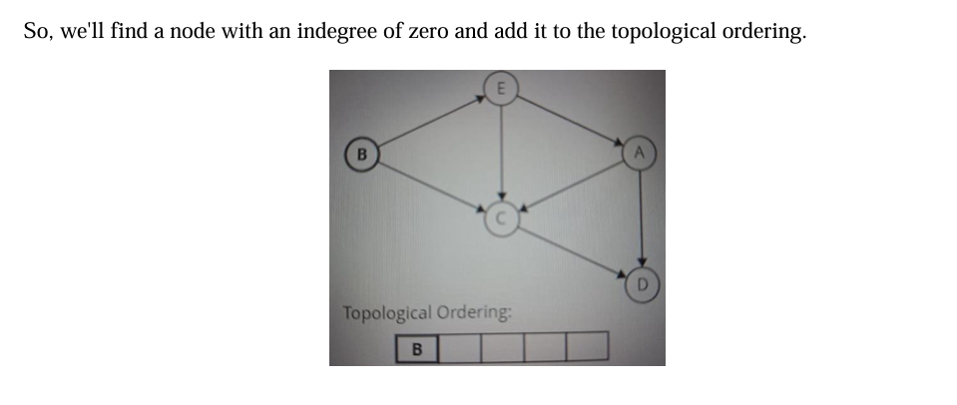

Slide 14
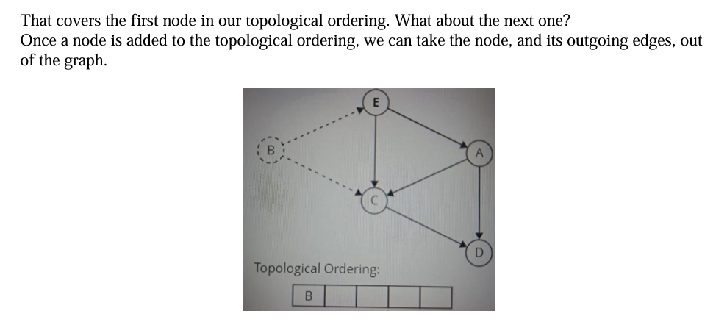

Slide 15
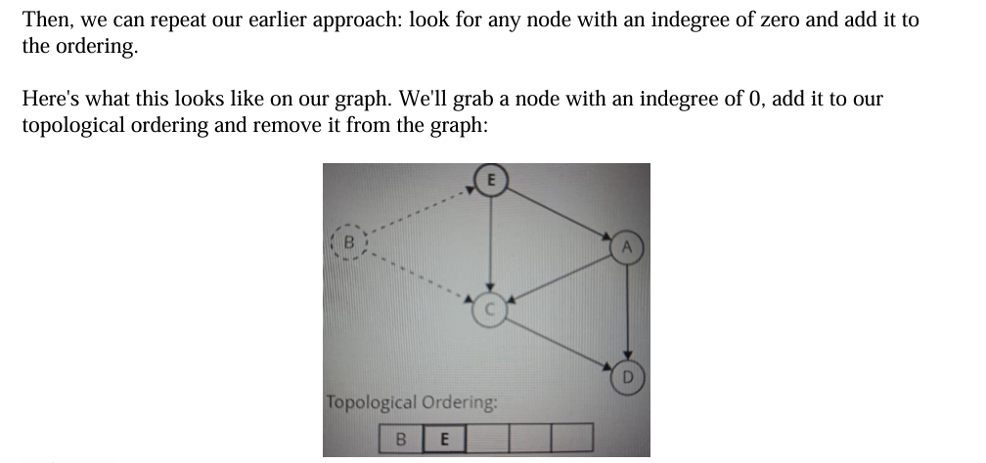

Slide 16
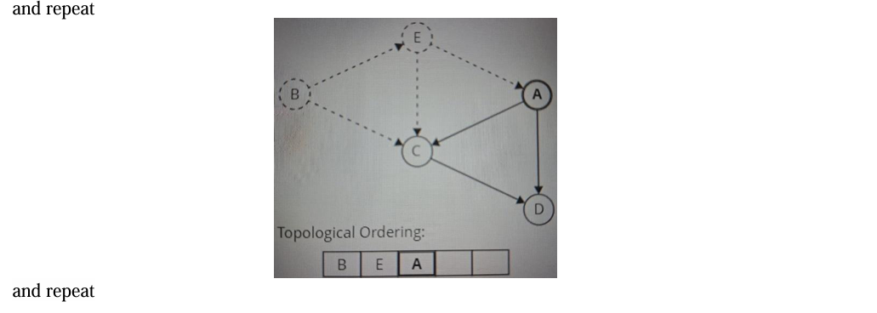

Slide 17
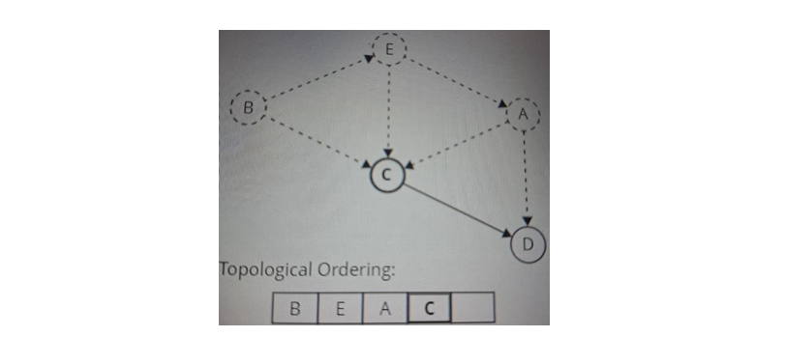

Slide 18
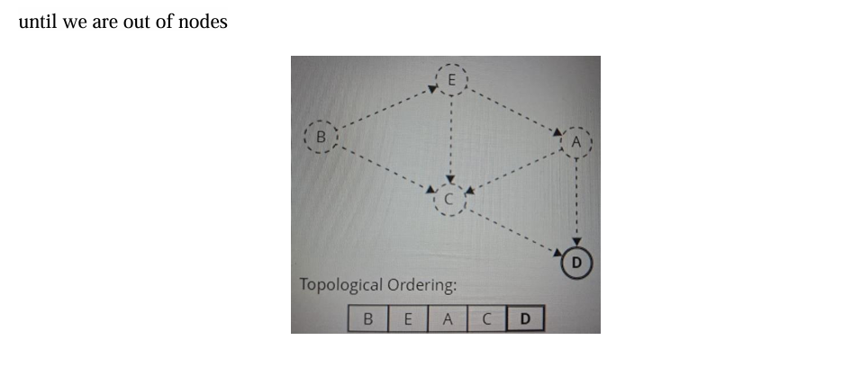

Slide 19
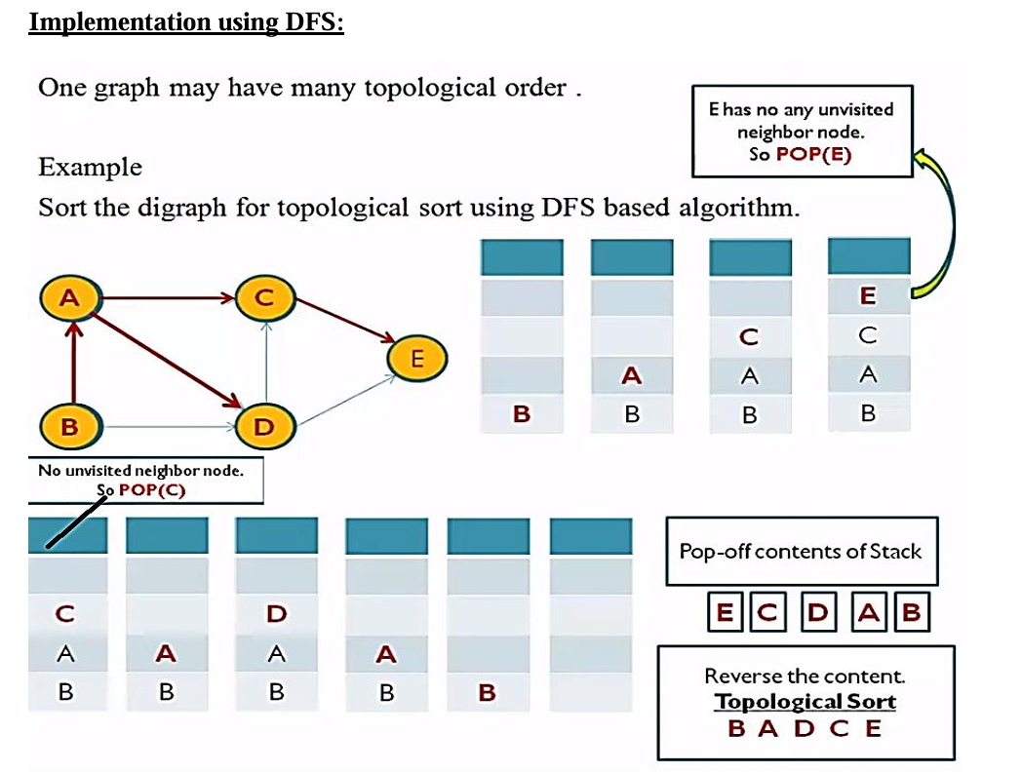

Slide 20
Applications:
Parallel Courses.
Course Schedule.

